Slide 1

<PROJECT TITLE>
LAKSHMI H
MES24MCA-2027
Department of Computer Applications
MES College of Engineering, Kuttippuram
20-08-2025

Slide 2
PRODUCT OWNER Ms.PRIYA J D ASSISTANT PROFESSOR DEPARTMENT OF COMPUTER APPLICATIONS MES COLLEGE OF ENGINEERING, KUTTIPPURAM

Slide 3
TABLE OF CONTENTS
Introduction
Objective
Existing System
Proposed System
Motivation
Functionalities
Module Description
Developing Environment
Sprint Backlog
Product Backlog
User Story
Project Plans
Data Flow Diagrams
ER Diagram

Slide 4
CHILD VACCINATION MANAGEMENT SYSTEM USING PYTHON
The Child Vaccination Management System is a digital solution designed to streamline the process of tracking and managing childhood immunizations.
With growing concerns around missed or delayed vaccinations, especially in developing regions, this system addresses the critical need for accurate and timely vaccine scheduling.
Parents and healthcare providers often face difficulties in maintaining manual records, resulting in inefficiencies and non-compliance with vaccination programs.
This project aims to create an efficient platform that automates vaccination tracking, ensuring children receive their immunizations as per the prescribed schedule.

Slide 5
OBJECTIVES
The core objective of this project is to design and implement a Child Vaccination Management System to ensure that children's vaccination data is securely stored and managed, and that parents receive timely notifications about upcoming doses. The hypothesis is:
A centralized, digital child vaccination platform will significantly improve vaccination coverage and reduce missed appointments in local communities.
This work builds upon concepts explored by Sharma et al.[1], who proposed mobile-based immunization reminder systems, and Qassem et al.[2], who outlined secure frameworks for health information systems. The system also draws implementation guidance from tutorials like “Building a Django-based Health Tracker”[3], and concepts from India’s eVIN network [4], which supports vaccine stock and logistics monitoring. Our system extends these efforts by focusing on end-user scheduling, child-wise tracking, and integration of admin/hospital modules for real-time vaccination updates.

Slide 6
EXISTING SYSTEM
Write Existing system using bullet points (1 Slide)

Slide 7
PROPOSED SYSTEM
Write Proposed system using bullet points (1 Slide)

Slide 8
MOTIVATIONS
In developing regions, child immunization rates are significantly affected by fragmented healthcare services and manual record-keeping.
Missed vaccination appointments, poor data access, and the absence of reminder systems are common problems.
Motivated by the public health importance of timely vaccinations, and inspired by existing digital health systems like India’s eVIN program, this project seeks to build a simplified, community-friendly tool for parents, healthcare providers, and administrators.
The platform will reduce human error, improve awareness, and facilitate efficient scheduling.

Slide 9
FUNCTIONALITIES
Admin Module:
Manage hospitals, view all appointments and child data, export vaccination reports.
Hospital Module:
Register and log in after admin approval, view appointments by date, update vaccination status.
Parent Module:
Register and manage their child’s profile, book appointments, view vaccination reminders and history, search for nearby hospitals.
Other Features:
Automated appointment reminders (email/SMS), login authentication, role-based access.

Slide 10
MODULE DESCRIPTION
Admin Module:
Manage hospitals, view all appointments and child data, export vaccination reports.
Hospital Module:
Register and log in after admin approval, view appointments by date, update vaccination status.
Parent Module:
Register and manage their child’s profile, book appointments, view vaccination reminders and history, search for nearby hospitals.
Other Features:
Automated appointment reminders (email/SMS), login authentication, role-based access.

Slide 11
DEVELOPING ENVIRONMENT
Operating System: Windows 10 or higher
Frontend: HTML5, CSS3, JavaScript (Bootstrap)
Backend: Python (Django Framework)
Database: MySQL / SQLite
IDE: Visual Studio Code / Sublime Text
Other Tools: XAMPP, Django REST Framework (optional), Git for version control

Slide 12
SPRINT BACKLOG
Backlog tem | Status And Completion Date | Original Estimation in Hours | Day 1 hrs | Day 2 hrs | Day 3 hrs | Day 4 hrs | Day 5 hrs | Day 6 hrs | Day 7 hrs | Day 8 hrs | Day 9 hrs | Day 10 hrs
SPRINT1
Table designing | 16/8/2022 | 2 | 1 | 1 | 0 | 0 | 0 | 0 | 0 | 0 | 0 | 0
Form designing | 22/8/2022 | 3 | 1 | 1 | 1 | 0 | 0 | 0 | 0 | 0 | 0 | 0
Coding | 27/8/2022 | 3 | 1 | 1 | 1 | 0 | 0 | 0 | 0 | 0 | 0 | 0
SPRINT 2
Data collection | 13/9/2022 | 7 | 1 | 1 | 1 | 1 | 1 | 1 | 1 | 0 | 0 | 0
Data processing | 29/9/2022 | 7 | 1 | 1 | 1 | 1 | 1 | 1 | 1 | 0 | 0 | 0
The table given above is for reference only. Update/create a table with your data.

Slide 13
SPRINT BACKLOG
Backlog tem | Status And Completion Date | Original Estimation in Hours | Day 1 hrs | Day 2 hrs | Day 3 hrs | Day 4 hrs | Day 5 hrs | Day 6 hrs | Day 7 hrs | Day 8 hrs | Day 9 hrs | Day 10 hrs
SPRINT3
Course contents | 3/10/2022 | 7 | 1 | 1 | 1 | 1 | 1 | 1 | 1 | 0 | 0 | 0
Assassement | 20/10/2022 | 7 | 1 | 1 | 1 | 1 | 1 | 1 | 1 | 0 | 0 | 0
SPRINT 4
Certificate | 8/11/2022 | 7 | 1 | 1 | 1 | 1 | 1 | 1 | 1 | 0 | 0 | 0
Testing | 15/11/2022 | 7 | 1 | 1 | 1 | 1 | 1 | 1 | 1 | 0 | 0 | 0
TOTAL |  | 50 | 9 | 9 | 8 | 6 | 6 | 6 | 6
The table given above is for reference only. Update/create a table with your data.

Slide 14
PRODUCT BACKLOG
ID | NAME | PRIORITY <high/medium/low> | ESTIMATE (Hours) | STATUS <Planned/In progress/Completed>
1 | REGISTRATION | High | 5 | COMPLETED
2 | LOGIN | High | 5 | COMPLETED
3 | CRUD(Course,Student,University) OPERATIONS | High | 20 | COMPLETED
4 | STUDENT ENROLLMENT | High | 10 | COMPLETED
5 | CERTIFICATE GENERATION | MEDIUM | 10 | COMPLETED
The table given above is for reference only. Update/create a table with your data.

Slide 15
USER STORY
User Story ID | As a type of User | I want to <Perform some task> | So that i can <Achieve Some Goal>
1 | ADMIN | Login | Manage the system
2 | ADMIN | View and Manage | Approve or reject them and can oversee the vaccination process.
3 | ADMIN | Export | Maintain official records.
4 | ADMIN | Monitor | Ensure smooth operations.
5 | PARENT | Register and Login | securely access my child’s vaccination records.
6 | PARENT | Add | Keep track of their vaccination history.
7 | PARENT | Update or Delete | Ensure the information is accurate.

Slide 16
USER STORY
User Story ID | As a type of User | I want to <Perform some task> | So that i can <Achieve Some Goal>
8 | PARENT | Search | Book vaccinations conveniently.
9 | PARENT | Book | Ensure my child gets vaccinated on time.
10 | PARENT | View | Track completed and pending vaccines.
11 | PARENT | Recieve | Not miss any scheduled vaccination dates.
12 | HOSPITAL | Register | Offer vaccination services.
13 | HOSPITAL |  | Start managing appointments.
14 | HOSPITAL | View | Prepare for scheduled vaccinations..

Slide 17
USER STORY
User Story ID | As a type of User | I want to <Perform some task> | So that i can <Achieve Some Goal>
15 | HOSPITAL | Update | Parents know if the vaccine was administered.
16 | HOSPITAL | Filter | Plan my daily schedule effectively.

Slide 18
PROJECT PLAN
User StoryID | Task Name | Start Date | End Date | Days | Status
1 | Sprint 1 | 16/08/2022 | 17/08/2022 | 10 | Completed
4 |  | 18/08/2022 | 19/08/2022 |  | Completed
5 |  | 20/08/2022 | 22/08/2022 |  | Completed
10 |  | 23/08/2022 | 24/08/2022 |  | Completed
11 |  | 25/08/2022 | 27/08/2022 |  | Completed
2 | Sprint 2 | 13/09/2022 | 23/09/2022 | 16 | Completed
7 |  | 23/09/2022 | 24/09/2022 |  | Completed
12 |  | 24/09/2022 | 29/09/2022 |  | Completed
The table given above is for reference only. Update/create a table with your data.

Slide 19
PROJECT PLAN
User StoryID | Task Name | Start Date | End Date | Days | Status
3 | SPRINT 3 | 03/10/2022 | 06/10/2022 | 14 | Completed
6 |  | 07/10/2022 | 10/10/2022 |  | Completed
13 |  | 13/10/2022 | 20/10/2022 |  | Completed
14 | SPRINT 4 | 28/10/2022 | 5/11/2022 | 10 | Completed
8 |  | 7/11/2022 | 11/11/2022 |  | Completed
9 |  | 13/11/2022 | 15/11/2022 |  | Completed
The table given above is for reference only. Update/create a table with your data.

Slide 20
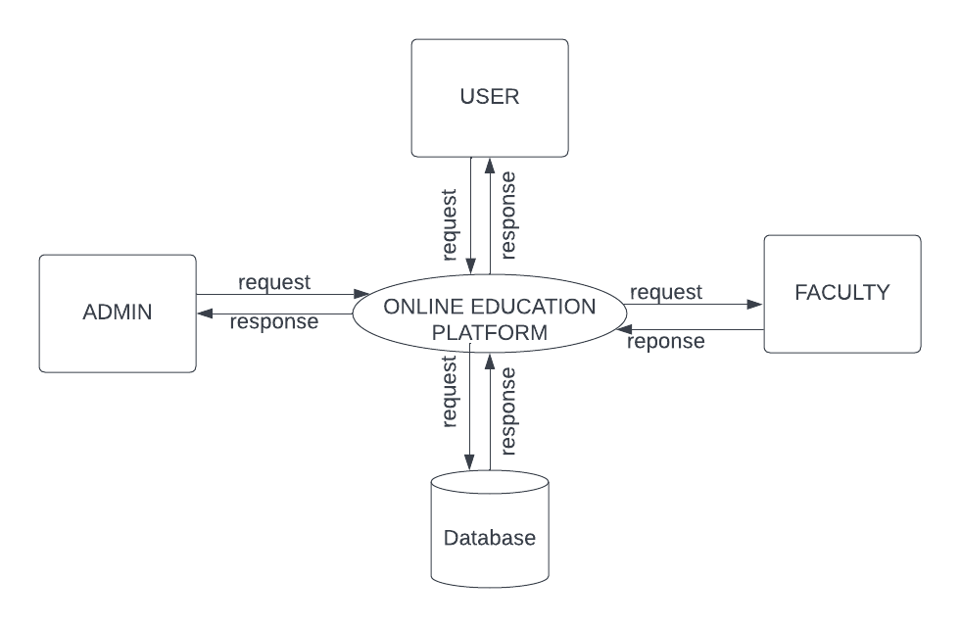
DATA FLOW DIAGRAM
LEVEL 1
The figure given above is for reference only. Create a figure with your data.

Slide 21
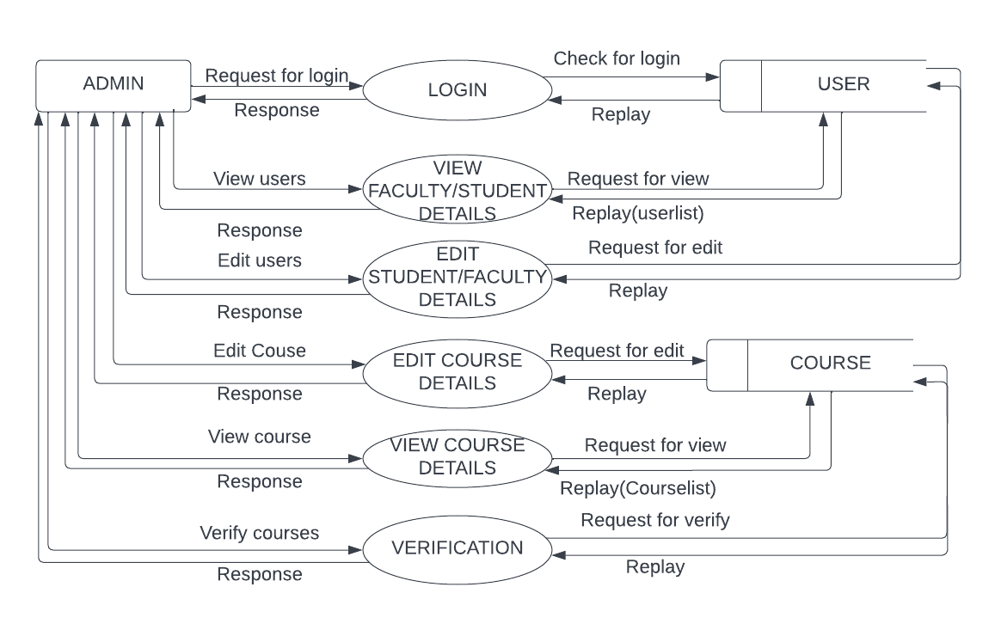
DATA FLOW DIAGRAM
Level 1.1
The figure given above is for reference only. Create a figure with your data.

Slide 22
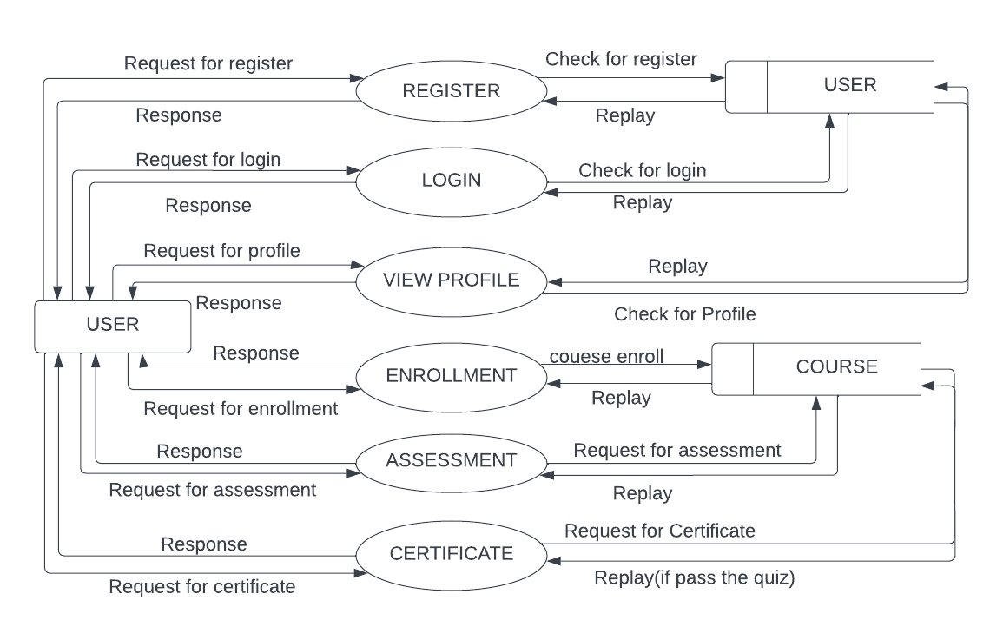
DATA FLOW DIAGRAM
Level 1.2
The figure given above is for reference only. Create a figure with your data.

Slide 23
ER DIAGRAM
Place you ER Diagram (if any) here.

Slide 24
THANK YOU

